Slide 1

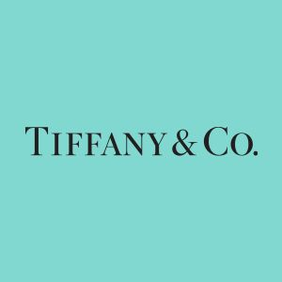

CS677 Final Project (NLP) Sentiment Analysis using VADER on Tweets
Tzupin Kuo
Dec 10, 2019

Slide 2
Sentiment Analysis
What
The process of ‘computationally’ determining whether a piece of sentence is positive, negative, or neutral (i.e., Polarity). Also known as opinion mining.
Why
A very useful tool for identifying the public sentiments on fields such as Business, Politics, Public Relations, social phenomena, etc.
And ,when it comes to Financial field, it could be used to understand the public sentiments for things such as Company’s merging/acquisition, quarterly/annually positive results published, leadership changed for good, etc.

Slide 3
Sentiment Analysis
Who
Researcher, marketer, Analyst, Politician, etc.
How
1. Polarity Detection (positive/negative/neutral)
2. Emotion Detection (happy/sad/angry etc)
3. Intent Detection (e.g. underlying complaint in a product review)

Slide 4
Sentiment Analysis
Extracting tweets’ sentiments using VADER
Excellent article by @ johngapper # TiffanyAndCo # LVMH # luxurylifestyle # Diamonds | Positive
I am so disappointed. # TiffanyAndCo # FightForFreedomStandWithHongKong | Negative
just like me! But I'm proud of it and I know it will taste amazing! # alltheworldsamage # bakingftw # tiffany # tiffanyandco # tiffanyblue | Positive
Now this is just wrong!!! We need Tiffanyâ€™s at a time like this!!!! # TiffanyAndCo # HurricaneDorainpic.twitter.com | Negative
I have the very best mom and sister in the world They have spoiled me so much for my birthday!! # birthdaygirl # birthdaypresent # tiffanyandco # imsospoiled # mymomisbetterthanyours | Positive
Which
Rule-based (or lexical) :
- VADER
- TextBlob
Machine Learning based :
Standford CoreNLP (RNN)
LSTM RNN

Slide 5
Procedures
Data Collection
Preprocessing
Vader Sentiment Extraction
Visualization
Twitter Data
Official Twitter API
Tweepy (API Wrapper)
Stock Data
Yahoo Finance
Remove URLs
Remove Special chars
Remove Stopwords
Sentiment score
-1 to 1
(most negative/most positive)
Plotly:
Interactive candle chart (stock price)
Interactive bar chart (sentiment score)
Matplotlib:
Scatterplot
Libraries used : Pandas, Numpy, VaderSentiment, Matplotlib, Plotly

Slide 6
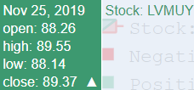
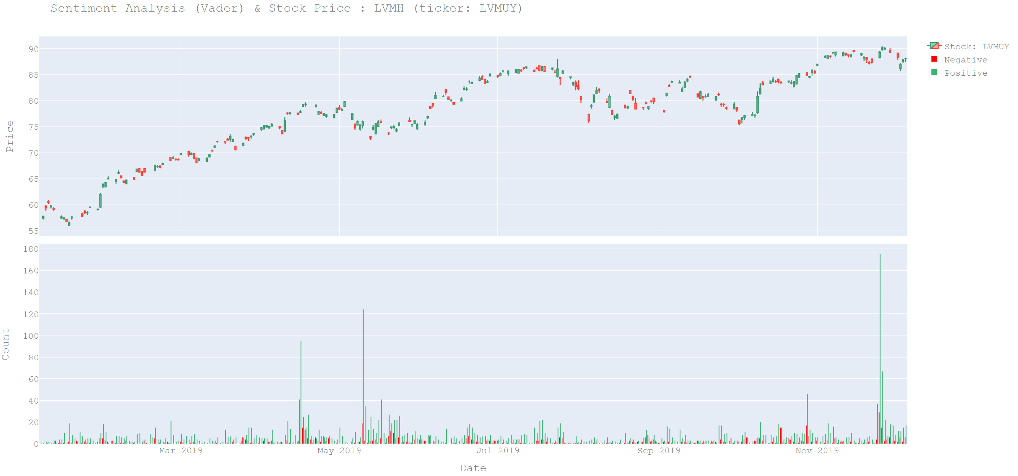
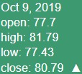
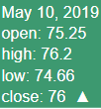
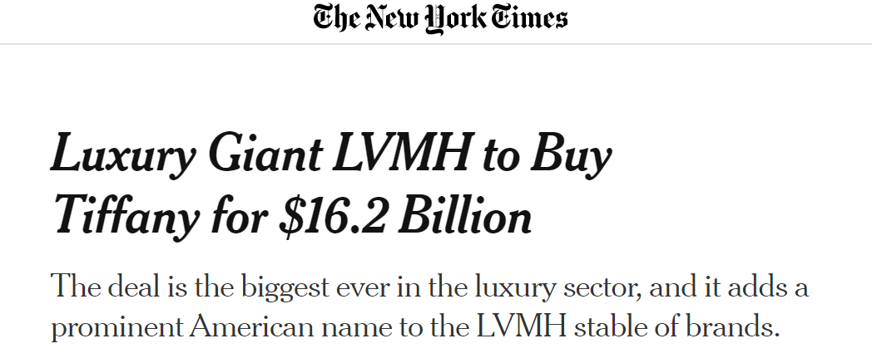
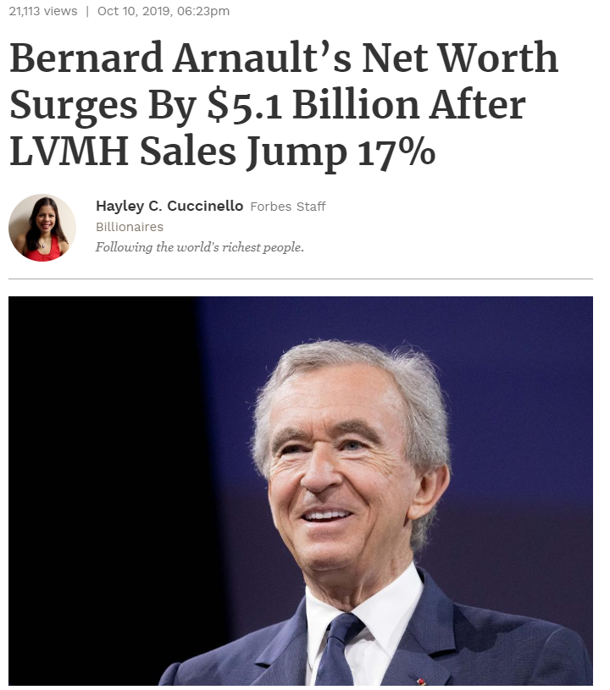
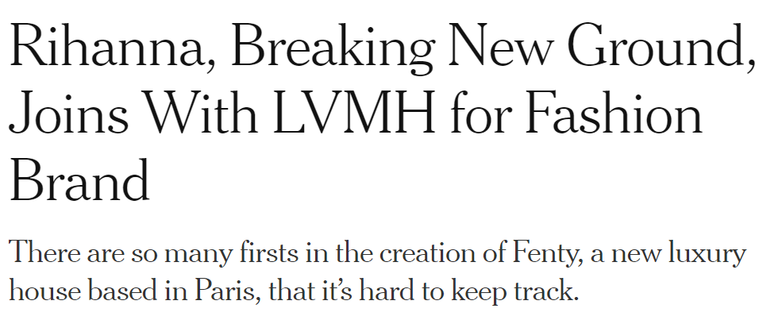
LVMH Moët Hennessy (LVMUY)

Slide 7
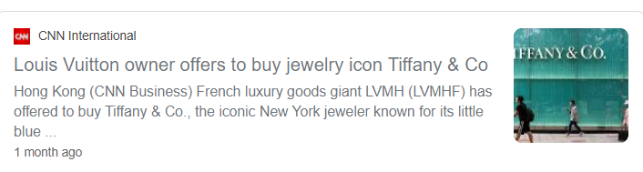
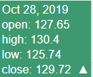
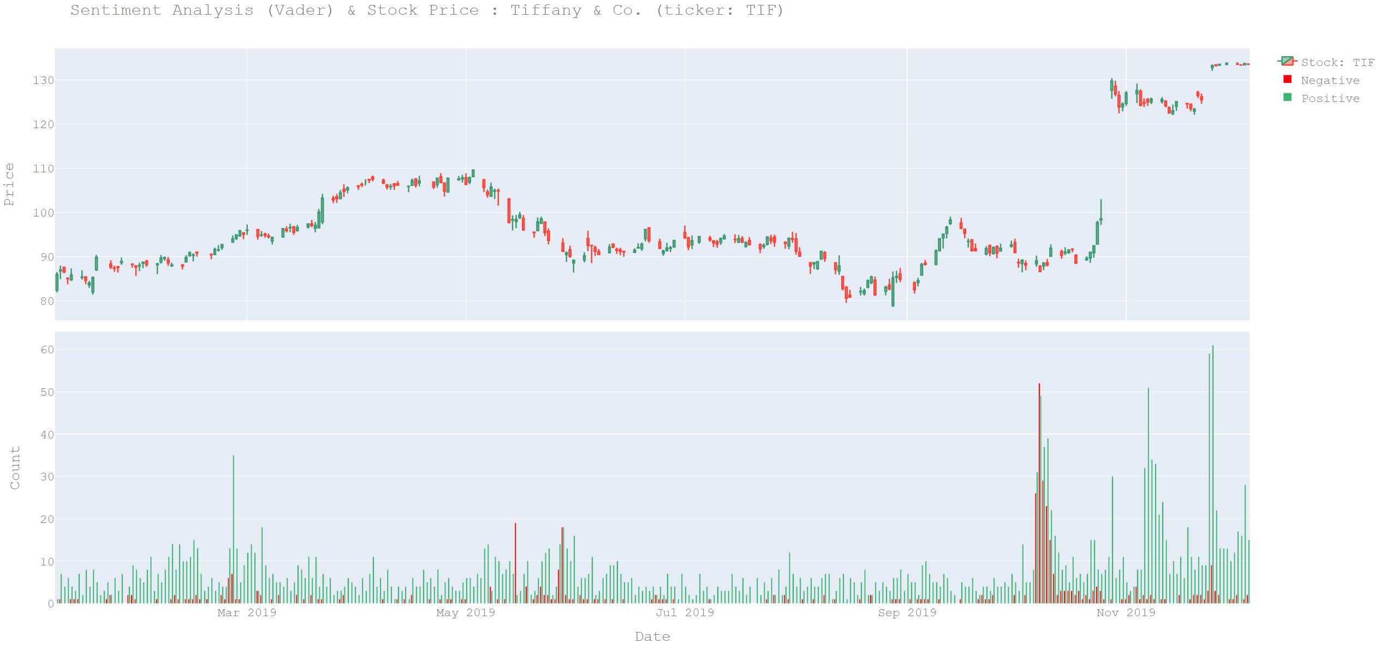
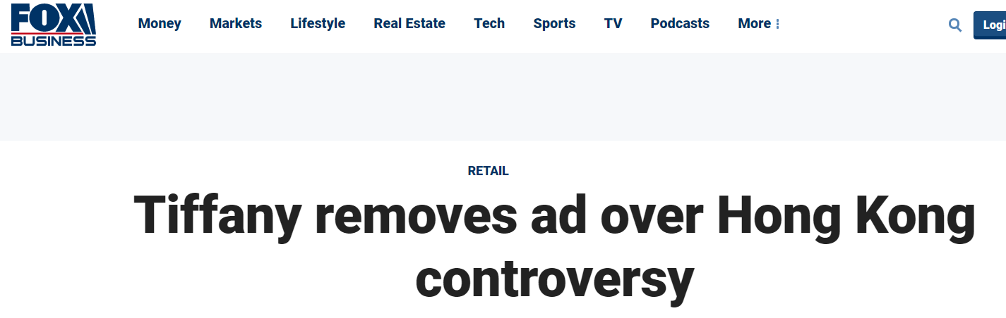
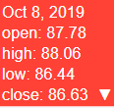
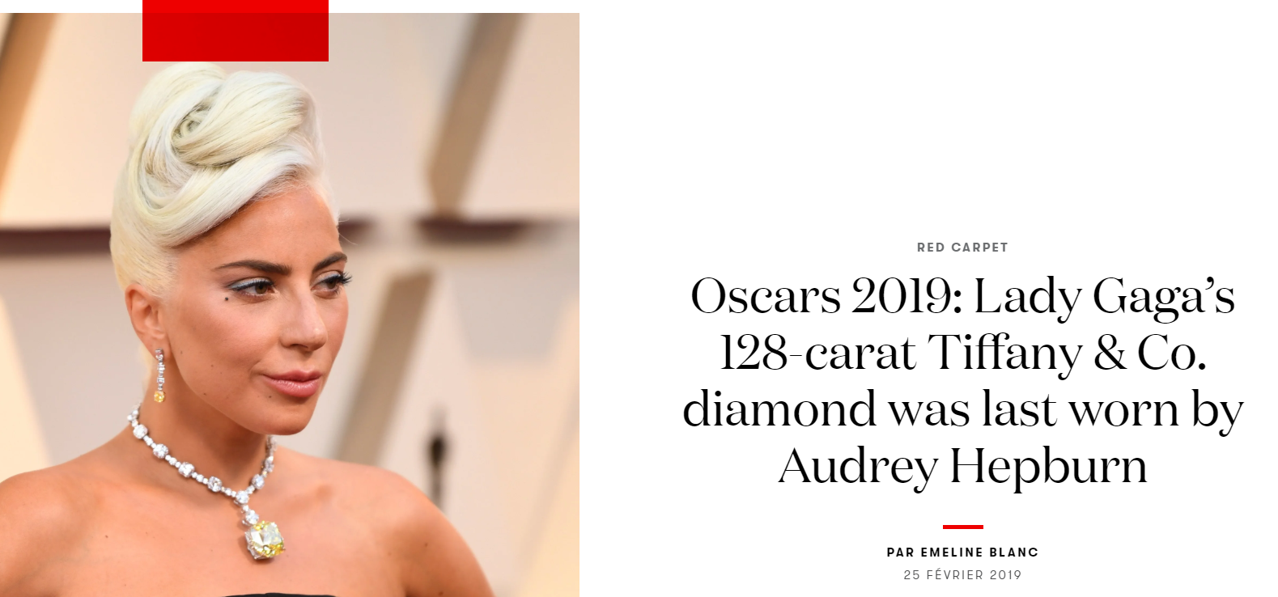
Tiffany & Co. (TIF)

Slide 8
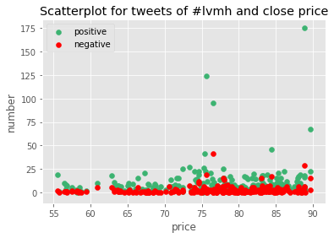
Correlation Analysis - LVMH Moët Hennessy (LVMUY)
v_pos v_neg price
v_pos 1.000000 0.773049 0.140242
v_neg 0.773049 1.000000 0.138225
price 0.140242 0.138225 1.000000

Slide 9
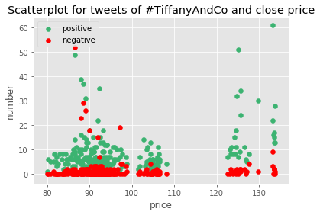
Correlation Analysis - Tiffany & Co. (TIF)
v_pos v_neg price
v_pos 1.000000 0.523049 0.353015
v_neg 0.523049 1.000000 -0.040759
price 0.353015 -0.040759 1.000000

Slide 10
Conclusion
In this analysis, I have shown that a little bit positive correlation exists between rise/fall in stock prices of a company to the public opinions (especially positive tweets) expressed on twitter.
But other than those ‘big news days’, it would be hard to tell the effectiveness of public sentiments (through tweets) on stock price fluctuation on those regular days.
We can set a threshold and only use the “spikes” on positive/negative tweets for stock price prediction.

Slide 11
Future Work
Use different combination of keywords and assign weights to them for reducing biases.
Gather data from different sources such as other social medium (Instagram, Facebook, etc), and news headline on forums/new webs. Assign weights to them to reduce the biases.
Use advanced Machine Learning based approach instead to extract sentiment score (LSTM & BERT) for a better accuracy.

Slide 12

THANK YOU! ANY QUESTION?

